Slide 1


Slide 2
Software Engineering Theory and Lab
FYMCA AY2425
By
Prof. Nikhita Mangaonkar

Slide 3
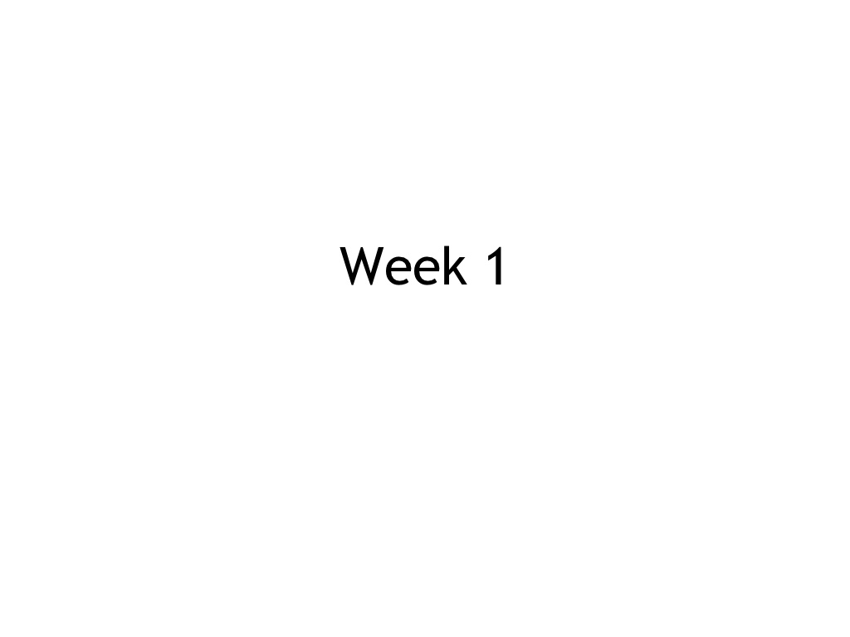

Slide 4
WELCOME
Introduction
What we will be doing this semester
Assessments

Slide 5
About the Course
3 Hrs Theory (3 Credits)
2 Hrs/batch Practical (1 Credits)

Slide 6
Lecture and Practical timings
Theory : 01.30 to 2.30 p.m. Tuesday
11. 30 a.m. to 12.30 p.m. Thursday
10. 30 a.m. to 11.30 a.m Friday
Practical: Tuesday 2.30 to 04.30 p.m.(B)
Wednesday 9.30 to 11.30 a.m.(A)
Thursday 2.30 to 04.30 p.m.(C)
Friday 1.30 to 2.30 p.m.(D)

Slide 7
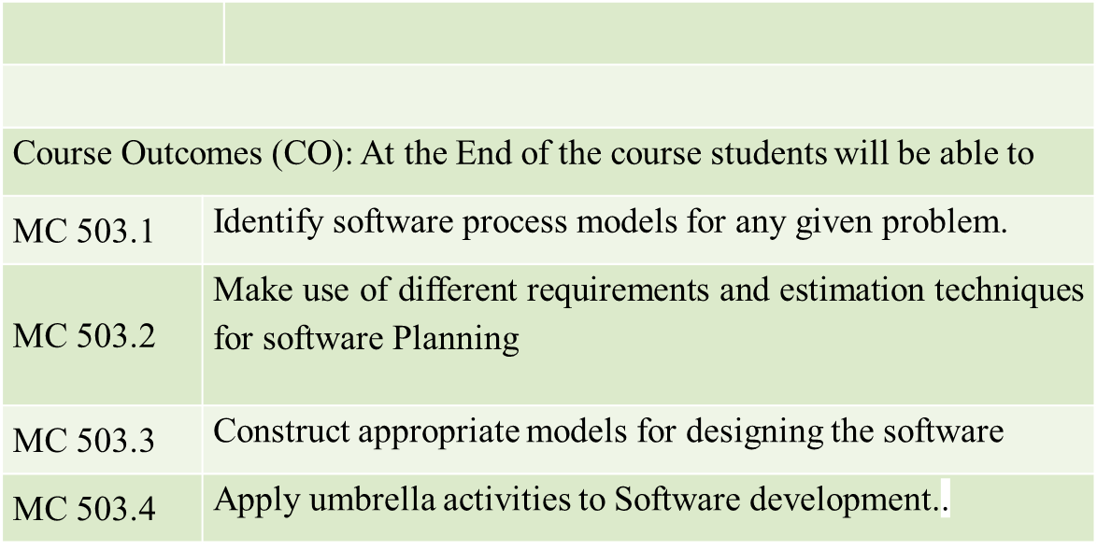
Course Outcomes

Slide 8
Syllabus
Module No. | Topics | Ref. | Hrs.
1 | Introduction to Software Process Models | 1,5 | 6
 | Software Engineering concepts and Process Models: Prescriptive Model , Evolutionary Process Model: Prototype and Spiral Model , Incremental Model : Iterative approach, RAD model
2 | Agile Process Models | 1,2,5 | 7
 | Agile Manifesto: Principles and Values of Agile, Extreme programming, Scrum Life cycle, Feature Driven Development (FDD),Agile Requirements: User stories, Epics CRC,Product Backlog Management
3 | Requirement Management and Project Scheduling | 1,2,6 | 9
 | Functional and Nonfunctional Requirement Elicitation :Interviews ,Questionnaire, Brainstorming, Facilitated Application Specification Technique , Requirement Analysis, Feasibility Study, Types of Feasibility, Software Requirement Specification, Validation Work Breakdown Structure, Gantt Chart, Pert Chart, Critical Path, Agile Estimation Techniques - Planning Poker-Shirt Sizes. Dot Voting, Bucket System.
4 | Software Design | 5,6 | 7
 | Architectural Design: Client Server, Pipe and Filter. Overview of UML Diagrams : Behavioral and Implementation view ,Design Patterns – Gang of four patterns.
5 | Software Testing | 1,5 | 5
 | Verification & Validation, Overview of White Box Testing and Black Box Testing, Overview of Testing strategies and Agile Testing
6 | Software Umbrella Activities | 2,4 | 8
 | Risk Management Risk Identification, Risk Assessment, Risk Projection, RMMM ,Software Configuration Management, SCM process, version and change control, Overview of SQA ,McCall’s Quality Model
 | Total |  | 42

Slide 9
Reference Books & Text Books
[1] Roger Pressman," Software Engineering: A Practitioner
Approach”,McGrawHill,10thEdition,2018.
[2] Ian Somerville, “Software Engineering”, Addison Wesley,
10thEdition, 2016.
[3]Mike Cohn, “Agile Estimating and Planning”, Prentice Hall,
6thEdition, 2018.
[4]Robert C. Martin, “Agile Software Development, Principles,
Patterns and Practices”, Pearson, 8thEdition,2013.
[5]Rajib Mall, “Fundamentals of Software Engineering”,PHI,5th
edition,2018.
[6]James Rambaugh,Michael Blaha, “Object Oriented Modeling and
Design with UML”,Prentice,2nd edition2012.

Slide 10
Examination Theory and Practical
ISE | MSE | ESE | Total
75 | 75 | 150 | 300
ISE | MSE | ESE | Total
50 | -- | 50 | 100

Slide 11
ISE components
MSE ( partial syllabus )
ESE (complete syllabus)
ISE
Sr. No. | Evaluation Component | Type of Exam | Marks | Tentative Date
1 | Group Activity (Case Study) CO3,CO4 | Demonstration, Subjective | 20 | First Week of November
2 | Quiz CO1,CO2 | Objective | 20 | Mid October

Slide 12
 | Presentation Marking Rubric (Group)
 | 4 | 3 | 2 | 1
Visual Appeal | There are no errors in spelling, grammar and punctuation. Information is clear and concise on each slide. Visually appealing/engaging. | There are some errors in spelling, grammar and punctuation. Too much information on two or more slides. Significant visual appeal. | There are many errors in spelling, grammar and punctuation. Too much information was contained on many slides. Minimal effort made to make slides appealing or too much going on. | There are many errors in spelling, grammar and punctuation. The slides were difficult to read and too much information had been copied onto them. No visual appeal.
Comprehension | Extensive knowledge of topic. Members showed complete understanding of assignment. Accurately answered all questions posed. | Most showed a good understanding of topic. All members able to answer most of audience questions. | Few members showed good understanding of some parts of topic. Only some members accurately answered questions. | Presenters didn’t understand topic. Majority of questions answered by only one member or majority of information incorrect.
Presentation Skills | Regular/constant eye contact, The audience was engaged, and presenters held the audience’s attention. Appropriate speaking volume & body language. | Most members spoke to majority of audience; steady eye contact. The audience was engaged by the presentation. Majority of presenters spoke at a suitable volume. Some fidgeting by member(s). | Members focused on only part of audience. Sporadic eye contact by more than one presenter. The audience was distracted. Speakers could be heard by only half of the audience. Body language was distracting. | Minimal eye contact by more than one member focusing on small part of audience. The audience was not engaged. Majority of presenters spoke too quickly or quietly making it difficult to understand. Inappropriate/disinterested body language.

Slide 13
Content | The presentation was a concise summary of the topic with all questions answered. Comprehensive and complete coverage of information. | The presentation was a good summary of the topic. Most important information covered; little irrelevant info. | The presentation was informative but several elements went unanswered. Much of the information irrelevant; coverage of some of major points. | The presentation was a brief look at the topic but many questions were left unanswered. Majority of information irrelevant and significant points left out.
Preparedness/ Participation/ Group Dynamics | All presenters knew the information, participated equally, and helped each other as needed. Extremely prepared and rehearsed. | Slight domination of one presenter. Members helped each other. Very well prepared. | Significant controlling by some members with one minimally contributing. Primarily prepared but with some dependence on just reading off slides. | Unbalanced presentation or tension resulting from over-helping. Multiple group members not participating. Evident lack of preparation/rehearsal. Dependence on slides.

Slide 14
Practical List
Prac. No. | Topic
01 | Practical 1 Part 1:Prepare Agile requirement using Scrum Lifecycle User Stories ,Epic
02 | Practical 1 Part 2: Prepare an Product Backlog.
03 | Practical 2: Prepare an SRS document.
04 | Practical 3: Design Use Case diagram and prepare the specification
05 | Practical 4 : Design Activity and Sequence diagram with specification
06 | Practical 5 : Design the Implementation and environmental view diagram
07 | Practical 6 Part 1 : Create Work Breakdown Structure
08 | Practical 6 Part 2 : Plan for development using Gantt chart
09 | Practical 7 : Use of Agile Estimation Techniques
10 | Practical 8 Part 1 : Prepare test cases and perform Unit Testing (test scenario, test cases, test data) Manual Testing
11 | Practical 8 Part 2 : Prepare test cases and perform Unit Testing (test scenario, test cases, test data)Automation Testing
12 | Practical 9 Using McCall’s Quality Factors for Project
12 | Practical 10 Part 1: Study of continuous Integration and development tools.
13 | Practical 10 Part 2: Study of continuous Integration and development tools.
14 | Revision

Slide 15
Rubrics for Evaluation
PI1: On Time | PI2:Performance | PI3: Documentation | PI5 : Lab Ethics | Marks Per Experiment
0.5 | 3 | 1 | 0.5 | 5
PI | Performance Indicators | Average | Good | Very good | Excellent
PI 1 | On Time | 0 (exceeded both due date and cutoff date) | 0.25(cutoff date) | 0.35(due date) | 0.5(Early submission)
PI 2 | Performance | 1(Improper and Incomplete Identification of Problem Parameters(Notations if any) ,Improper Case study Analysis),Not answered correctly | 2 (Partial Identification of Problem Parameters(Notations if any) ,Partial Case study Analysis) Partial Justification of answer | 2.5(Identification of Problem Parameters(Notations if any) ,complete Case study Analysis)answered correctly | 3 (Identification of Problem Parameters(Notations if any) ,Proper Case study Analysis)answered accurately with example
PI 3 | Documentation | 0.25(Templates followed with improper elaboration) | 0.5(Templates followed correctly with partial elaboration) | 0.75(Templates followed correctly with right elaboration) | 1(Templates followed correctly with precise elaboration)
PI 4 | Lab Ethics | 0(no response) | 0.25(Participative) | 0.35(Participative and obedient) | 0.5(Participative and obedie nt, encourages questions)

Slide 16
Any Questions???

Slide 17
IT Quadrants
CLIENT | PRODUCT
SOLUTION PROVIDERS | CONSULTANTS

Slide 18
Key terms
Project & Operations
Software development team adds a new feature to the application.
Sales and selling a product.
Automobile industry develops a website to streamline procurement.
Marketing a product

Slide 19
Key terms
Project - A project is any work that happens only once, has a clear beginning and end, is intended to create a unique product or knowledge.
Operations - Any repetitive activities in an organization.
According to IEEE “Software is a collection of computer programs, procedures, rules and associated documentation and data pertaining to the operation of a computer system.”

Slide 20
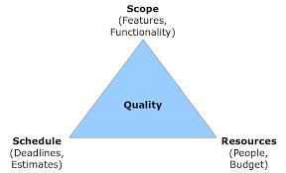
Triple Constraint of Project

Slide 21
The Evolving Role of Software
The following are the different eras’ of software engineering:
The Pioneering Era (1955-1965)
The Stabilizing Era (1965-1980)
The Micro Era (1980-Present)

Slide 22
1. The Pioneering Era (1955-1965)
As new computer systems were introduced very frequently. Software people had to rewrite all their programs to run on these new machines.
Using punched cards for input.
The field was so new that the idea of management by schedule was non-existent.
Making predictions of a project's completion date was almost impossible.

Slide 23
1. The Pioneering Era (1955-1965)
hardware was application-specific
Hardware vendors gave away systems software for free as hardware could not be sold without
software.
A few companies sold the service of building custom software but no software companies were selling packaged software.

Slide 24
2. The Stabilizing Era (1965-1980)
turnaround time, the time between job submission and completion. At worst it was measured in days.
Then came IBM 360. It signaled the beginning of the stabilizing era.

Slide 25
2. The Stabilizing Era (1965-1980)
The job control language (JCL) raised a whole new class of problems.
"Structured Programming" burst on the scene in the middle of this era.
PL/I, introduced by IBM to merge all programming languages into one, failed.
Most customized applications continued to be done in-house.

Slide 26
3. The Micro Era (1980-Present)
The price of computing has dropped dramatically making ubiquitous computing possible.
Now every programmer can have a computer on his desk. The old JCL has been replaced by the user-friendly GUI.

Slide 27
3. The Micro Era (1980-Present)
The most-used programming languages today are between 15 and 40 years old.
The Fourth Generation Languages achieved the dream of "programming without programmers”

Slide 28
Software myths
Management Myths
Myth:
We already have a book that's full of standards and procedures for building software.
Won't that provide my people with everything they need to know?

Slide 29
Software myths
Management Myths
Myth:
Development problems can be solved by using state-of-the art tools.
Tools may help, but there is no magic.

Slide 30
Software myths
Management Myths
Myth:
If we get behind schedule we can add more programmers and catch up.

Slide 31
Software myths
Customer Myths
Myth:
A general statement of need is sufficient to start coding

Slide 32
Software myths
Customer Myths
Myth:
Change is easily accommodated, since software is malleable.

Slide 33
Software myths
Practitioner's Myths
Myth:
Once we write a program and get it to work, our job is done.
Myth:
Until I get the program running I have no way of assessing its quality.

Slide 34
Software myths
Practitioner's Myths
Myth:
The only deliverable for a successful project is the working program

